Slide 1


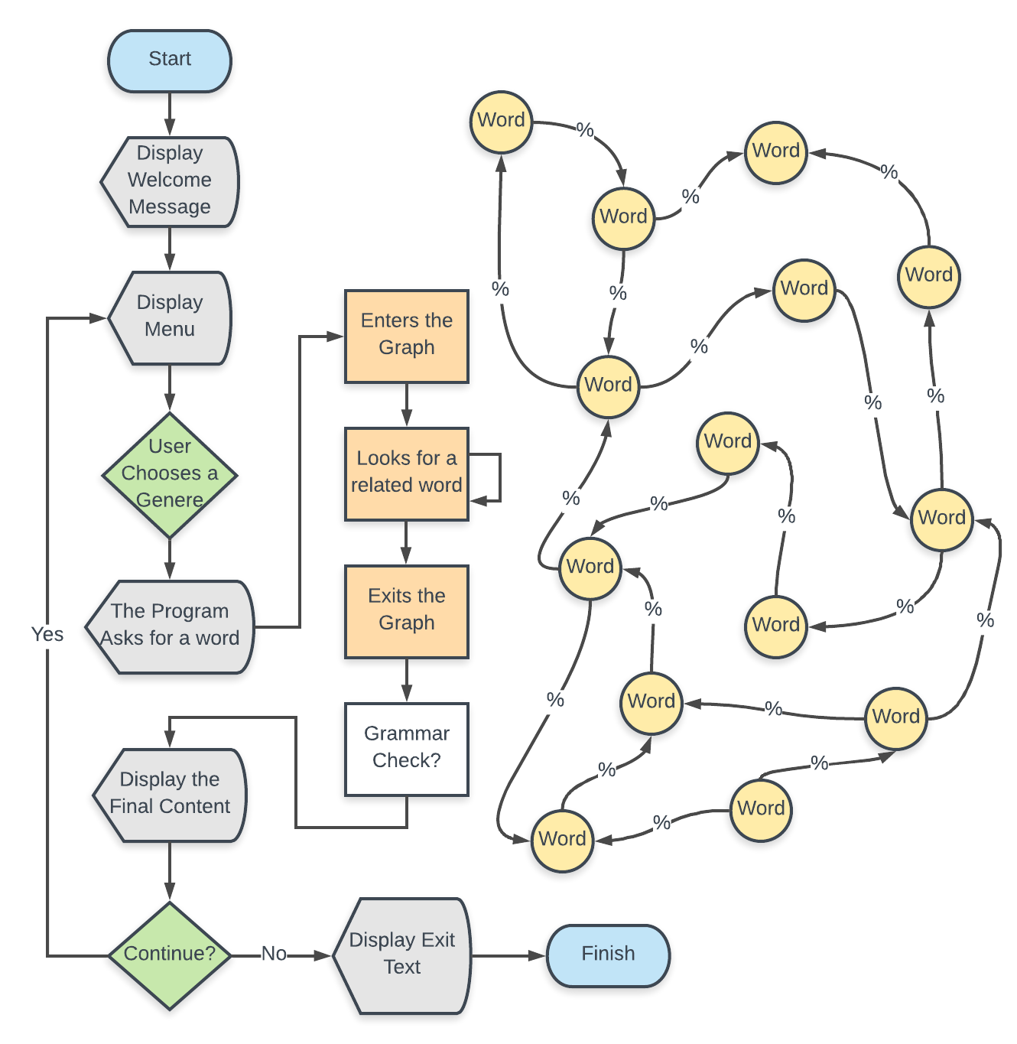
Weighted Graphs for Novel Phrases
Cooper Simpson and Zayna Sheikh
CSCI 2270: Data Structures
Fall 2018
Shayon Gupta
Abstract
Generating a Phrase
Final Product
The goal of the project was to create a phrase generator using the graph data structure. This program would take in a large data set of a given theme and based on user input, output a phrase matching that theme. If the data set contained book titles, and the user provided the word “Life” our program would use the graph to output a book title starting with the word “Life” .
In order to generate a phrase a graph must be built and then traversed. Using a data set the graph is built according to the guidelines outlined in the Initial Structure. After this is done, one is left with a weighted graph of where nodes represent words, and edges represent both a word following another word and the amount of times this was observed in the data set. With this one may traverse the graph in a probabilistic manner. By calculating the total weight of all edges stemming from a node and then dividing each edges weight by this number one gets a probability of taking that edge versus all the other edges. Computationally one can generate a random number and using this determine an edge to follow. This can be continued for a given length producing an output. Ideally we would have liked to implement other factors in determining path such as the grammatical type the word is, or the probabilities for multiple words in a row.
Categories and results
Final Program
Initial Structure
First approaching the project, it was clear that a graph would need to be implemented. The nodes of the graph are structs storing data on the word at that node among other things. Words are read in pairs of two from a phrase and an edge is either created or weighted between the two nodes representing the words.
In this first stage, the idea of a grammar check also came up but was not a requirement to implement. If there was time, it could be looked into but it would have added a whole different level of complexity to the project. Taking grammar into account would have provided more information for the nodes that could inform the traversal and output.
Conclusions
Challenges and Design Revisions
Overall our project produces desired output although variable in its meaning. Larger data sets and a more intricate design for graph traversal would allow for better output that more simulates real life phrases.
Two main challenges were encountered in this project. The first was outside of the code and lay in finding large, usable data sets for building the graphs. Second, in writing the code significant obstacles were encountered with pointers in the creation of the graph. To solve this problem the methodology of the functions was changed to use indices instead of pointers. It was later determined that the error was stemming from the dynamic resizing of the STL vector data structure.
Acknowledgements
The team would like to thank Manish Shambu, Alex Curtis and Shayon Gupta for their assistance with this project.

